Slide 1
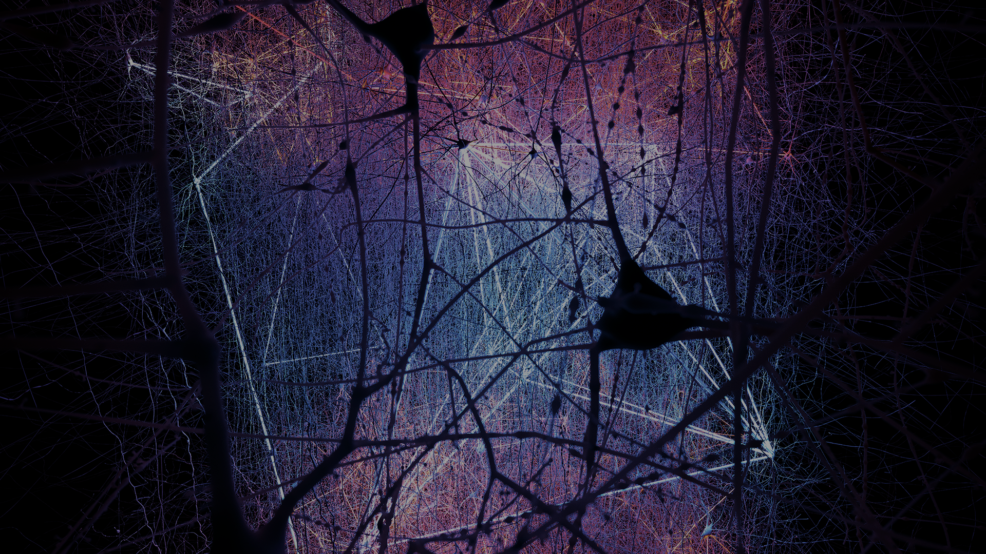

Topological Data Analysis:
extracting insights from the “shape” of data
55e Journées de statistique de la SFdS
27 May 2024
Notes:
Topology provides useful, revealing dimensionality reductions in neuroscientific data, but not only!
Image from our Blue Brain work, though that's not the subject today.

Slide 2
What is topology?

Slide 3
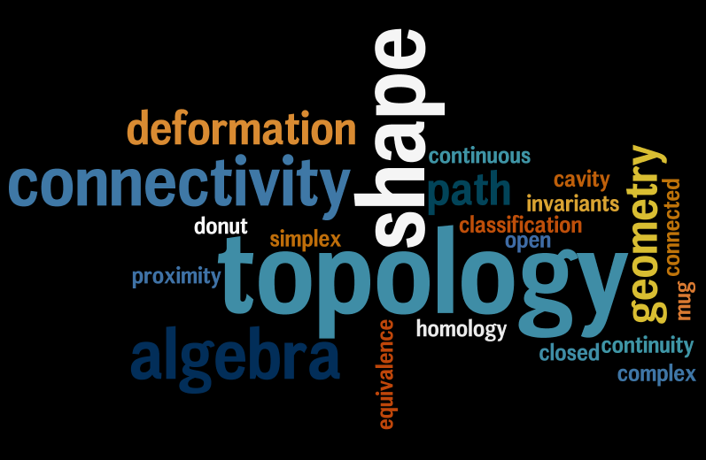
Notes:
The mathematics of shape, connectivity, and "local to global" emergent structure.

Slide 4
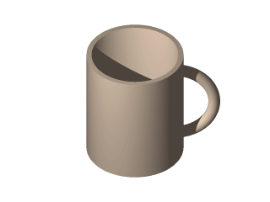
Topology is…
the mathematics of shape;

Slide 5
Topology is…
the mathematics of shape;
the mathematics of connectivity;

Slide 6

Topology is…
the mathematics of shape;
the mathematics of connectivity;
the mathematics of emergence of global structure from local constraints.
D. Benbennick, CC BY-SA 3.0
Notes:
Topology also provides an appropriate mathematical language in which to formulate conjectures and statements about emergence of global structure from local constraints, as well as tools to prove formally the emergence of such structure. The famous Möbius strip provides an example of such a global structure, driven by local constraints, since one can describe the Möbius strip in terms of line segments asssociated to each point of the circle, which are then glued together according to local constraints that build in the famous twist that leads the Möbius strip to have only one side.

Slide 7
Application to Data Science
The shape of a data set,
described by a topological signature
encoding its multi-scale structure,
can reveal important relations among the data points,
with the help of machine learning.
Topological Data Analysis (TDA)

Slide 8
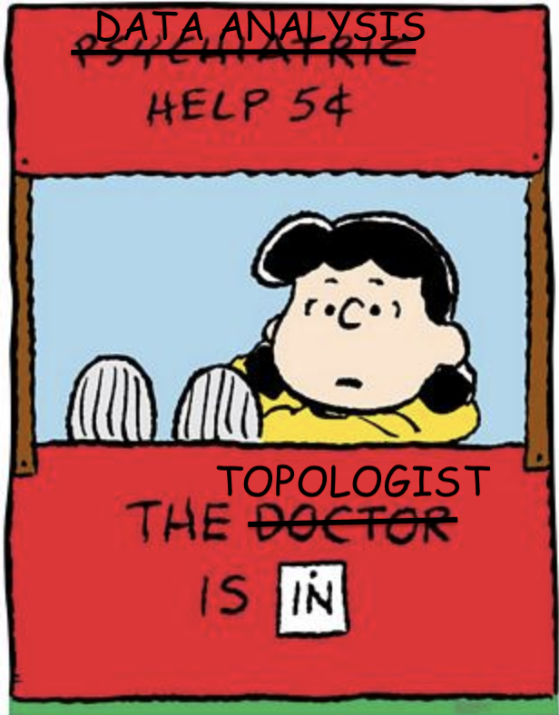

Slide 9
Topological analytical tools
Method | Appropriate data types
Mapper | Clinical data, metabolomics, genomics, etc.
Two-tier Mapper | Gene expression data, single-cell transcriptomics
Persistent homology | Connectivity data, high-dimensional point cloud data
Graph signal processing | Connectivity data + “signal”

Slide 10
Mapper

Slide 11
Overview
(Mostly) unsupervised mutivariate pattern analysis of high-dimensional data, retains more information than PCA
Produces a compressed visual representation of the data, providing a strong indication of where to look for meaningful clustering and encoding relations between clusters
Numerous remarkably successful applications
Input:
  Data set X equipped with notion of “distance” between points
  Real-valued “measurements” on X
  Decomposition of the real line into overlapping subsets
  Choice of clustering algorithm
Notes:
Let the data speak to us, indicating potentially meaningful clustering, then go to see whether the clusters do actually have any biological significance.
Wave hands about the process.

Slide 12
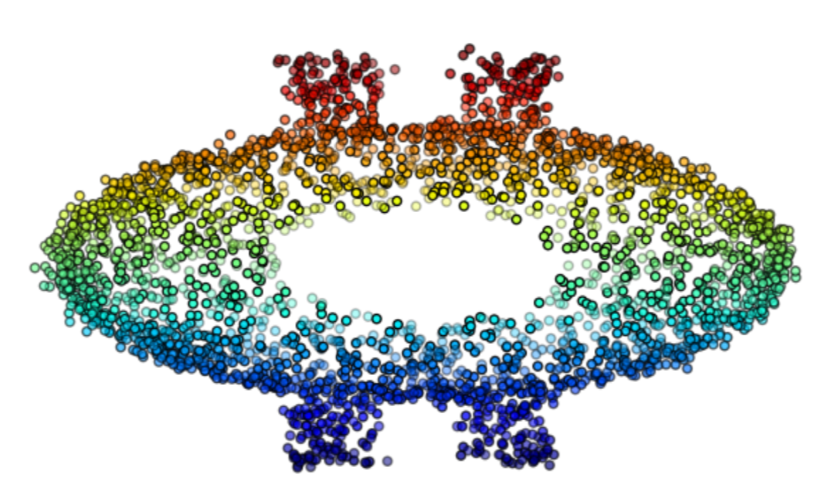
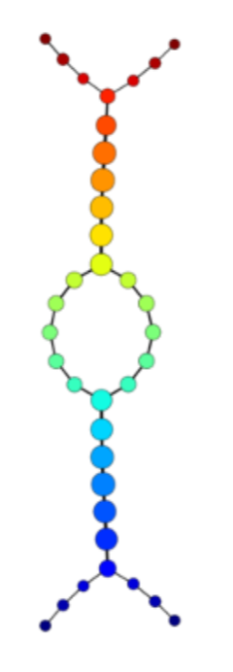
Mapper output: synthetic data
Masters thesis, F. Palma, 2018
Notes:
Measurement = temperature
Clustering = single-linkage

Slide 13
Mapper output: gene expression data
Levine, et al. PNAS 2011.
Notes:
Existence d’un type de cancer du sein inconnu avant (c-MYB+), représentant 7,5% des cas, ayant un taux de survie de 100% (suivi de 8,5 ans en moyenne), sans aucune récurrence, malgré grande déviance du profil génomique
Uniformité de la signature moléculaire et des propriétés cliniques des tumeurs c-MYB+
Le groupe de tumeurs c-MYB+ indétectable par méthodes statistiques traditionnelles
Existence du groupe de tumeurs c-MYB+ confirmée également en deux autres bases de données

Slide 14
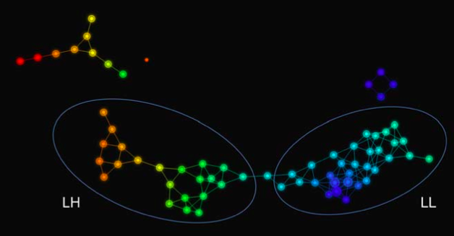
Mapper output: fMRI data
D. Romano et al, Human Brain Mapping 35:4904-4915 (2014)
Notes:
Mapper applied to vectorized voxel-based morphometry arising from fMRI of young boys suffering from Fragile X.
PCA1 and 2 for "measurements", Euclidean distance.
LH = larger grey and white matter volumes, worse clinical scores

Slide 15
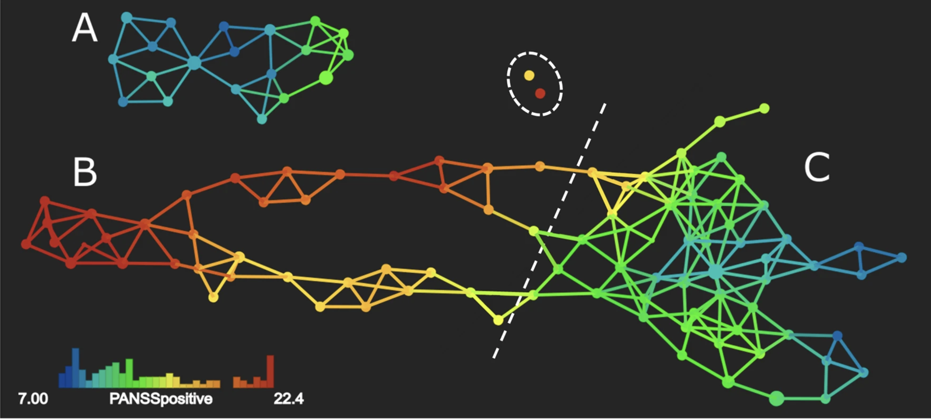
Mapper output: clinical profile data
Fournier, Scolamiero, et al., J Mol Psych, 2021.

Slide 16
Lee et al., Nature Communications 2017
Lee et al., J Chem Thy Comput 2018

Slide 17
Persistent homology

Slide 18
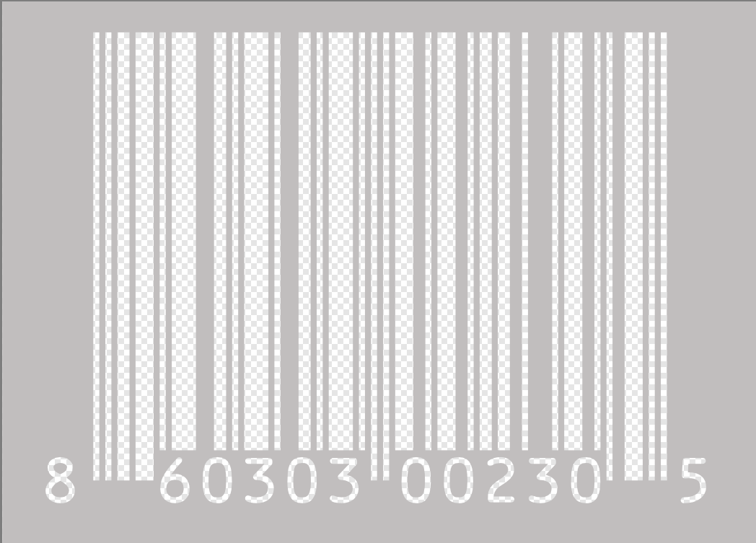
The basic persistence workflow
Data
Point cloud
Key notion: Filtration
Notes:
Mention alternate approach via sub- and/or super-level set.

Slide 19
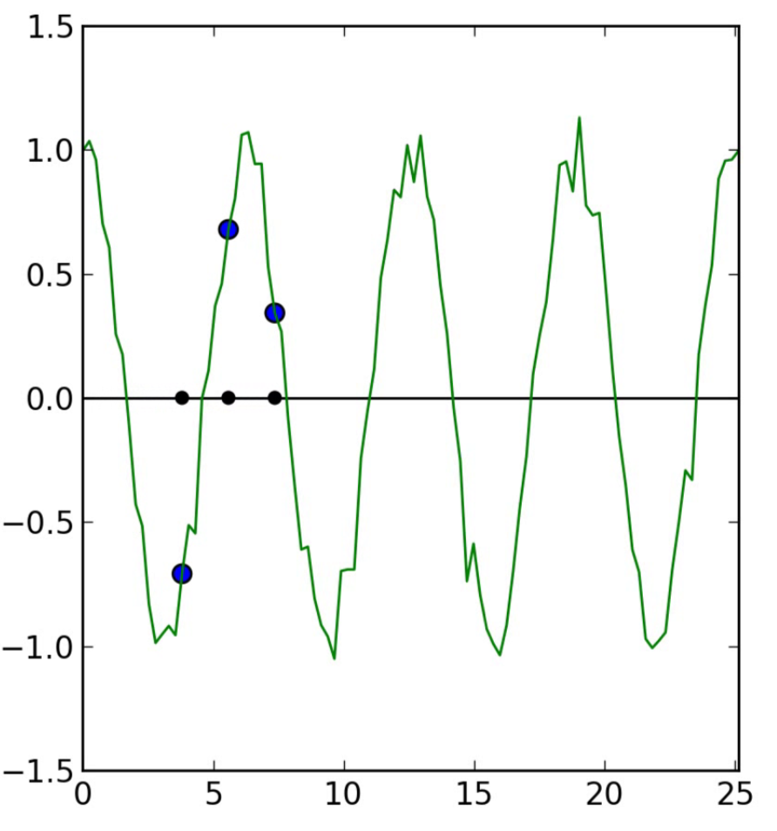
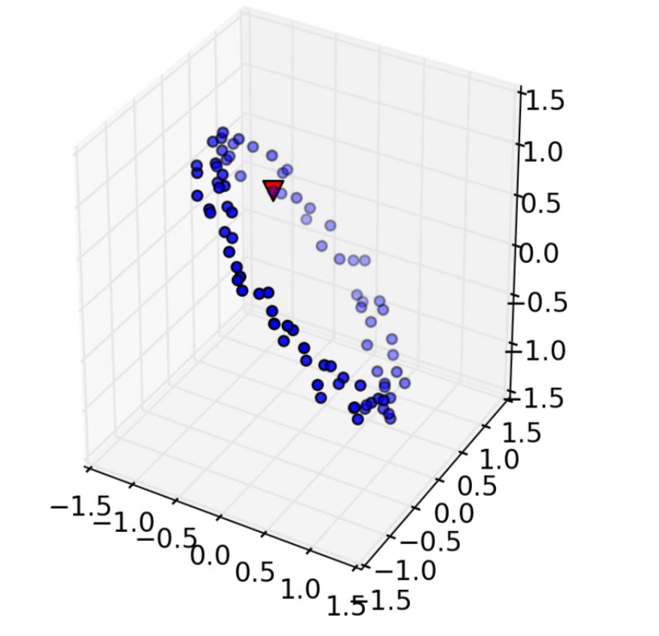
Step 1: Data to Point Cloud
L. Munch, 2019.

Slide 20
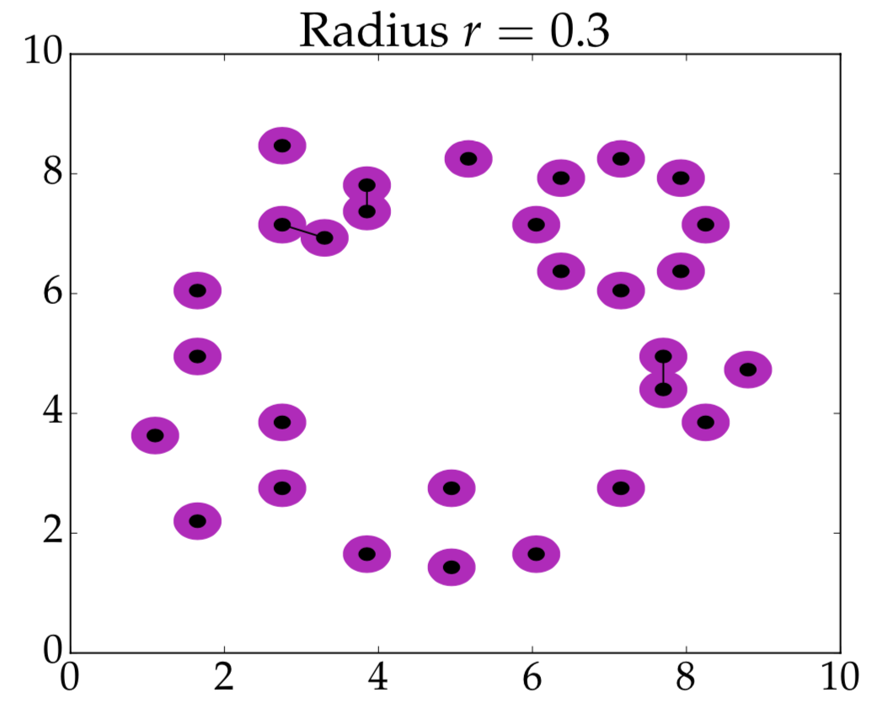
Step 2: Point cloud to nested complexes
L. Munch, 2019.

Slide 21
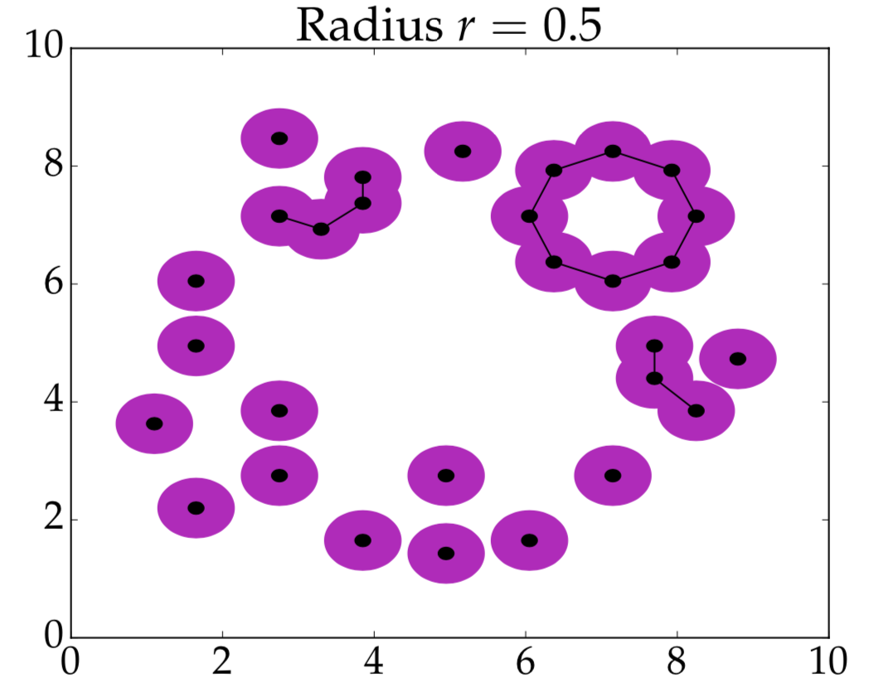
Step 2: Point cloud to nested complexes
L. Munch, 2019.

Slide 22
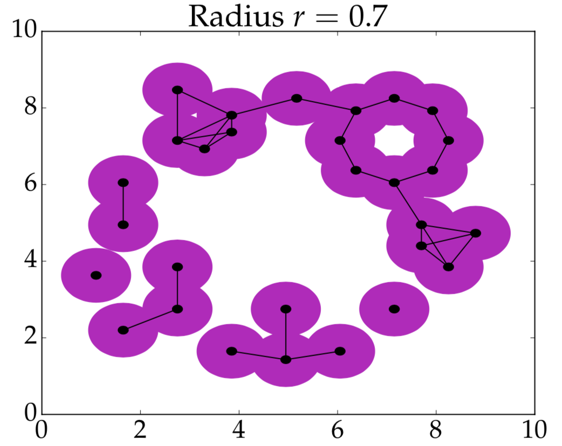
Step 2: Point cloud to nested complexes
L. Munch, 2019.

Slide 23
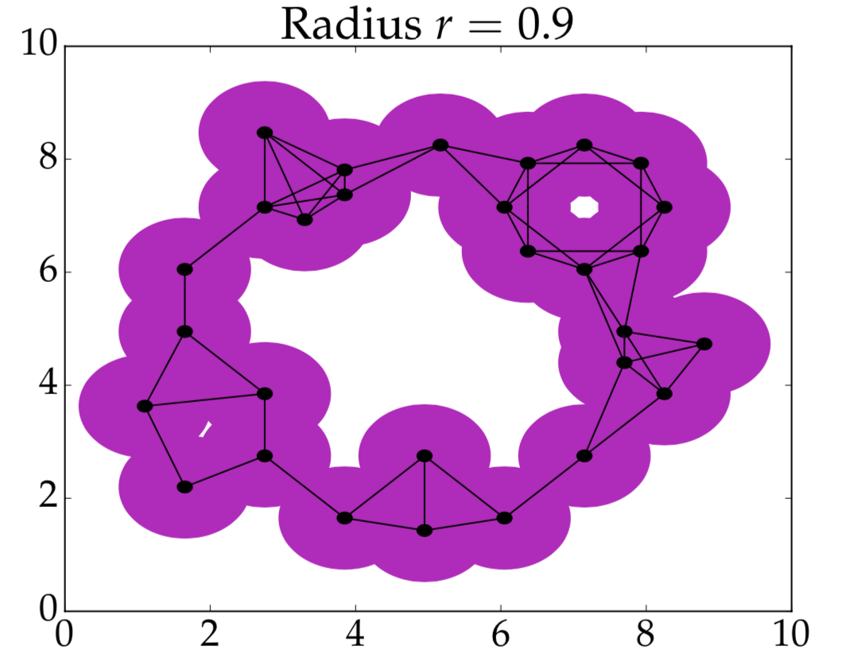
Step 2: Point cloud to nested complexes
L. Munch, 2019.

Slide 24
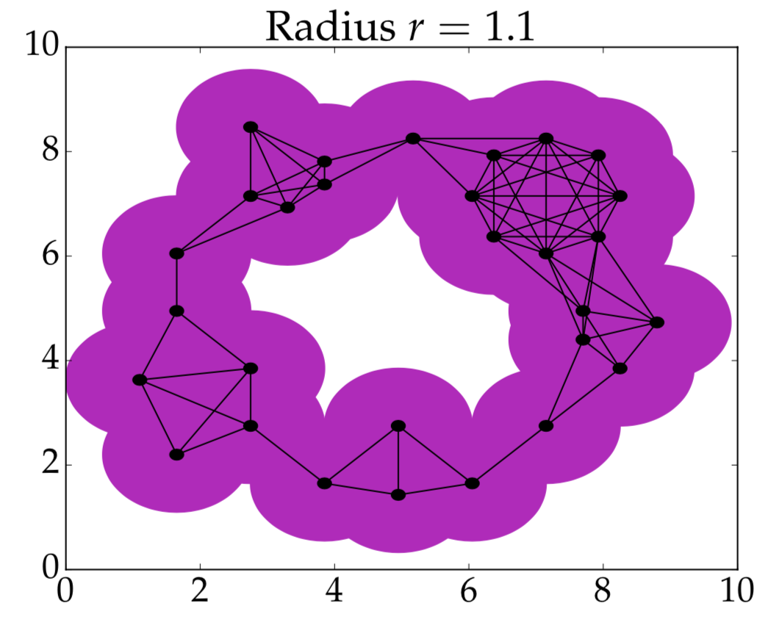
Step 2: Point cloud to nested complexes
L. Munch, 2019.

Slide 25
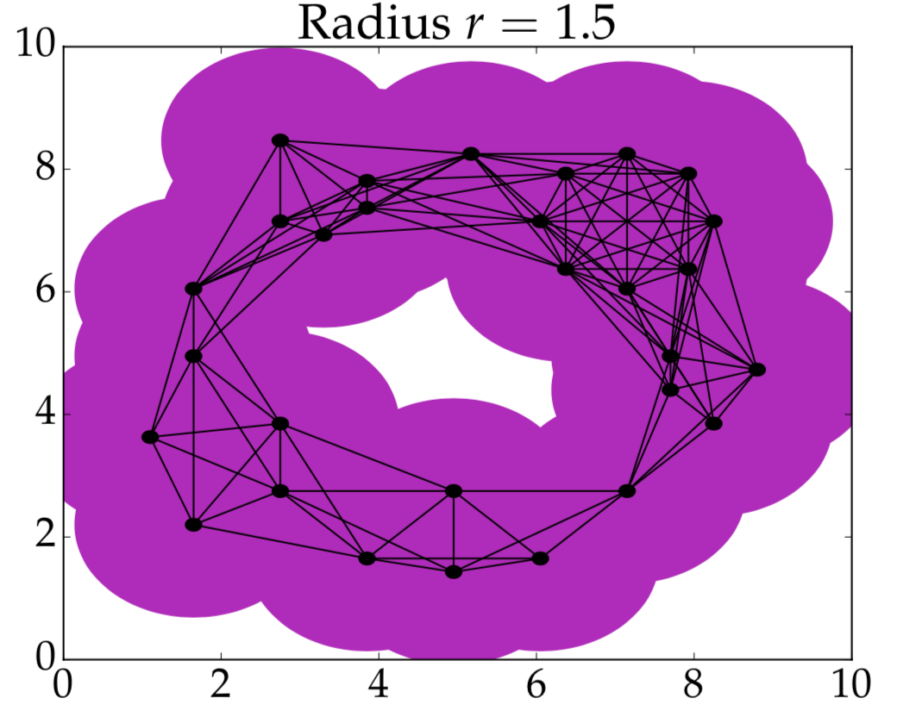
Step 2: Point cloud to nested complexes
L. Munch, 2019.

Slide 26
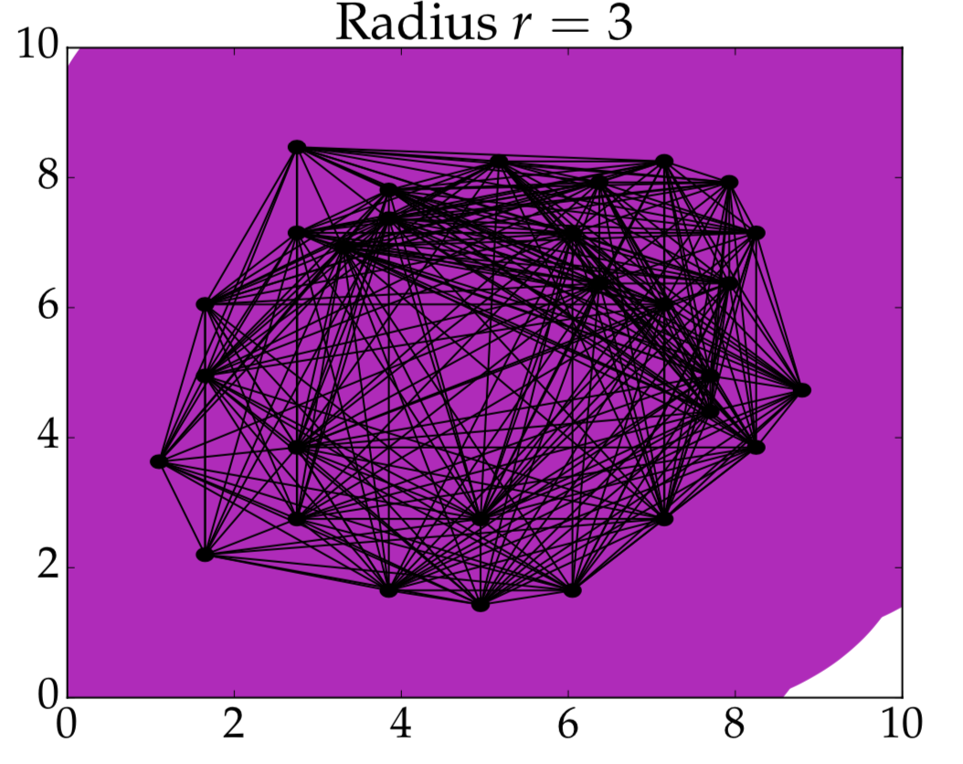
Step 2: Point cloud to nested complexes
L. Munch, 2019.

Slide 27
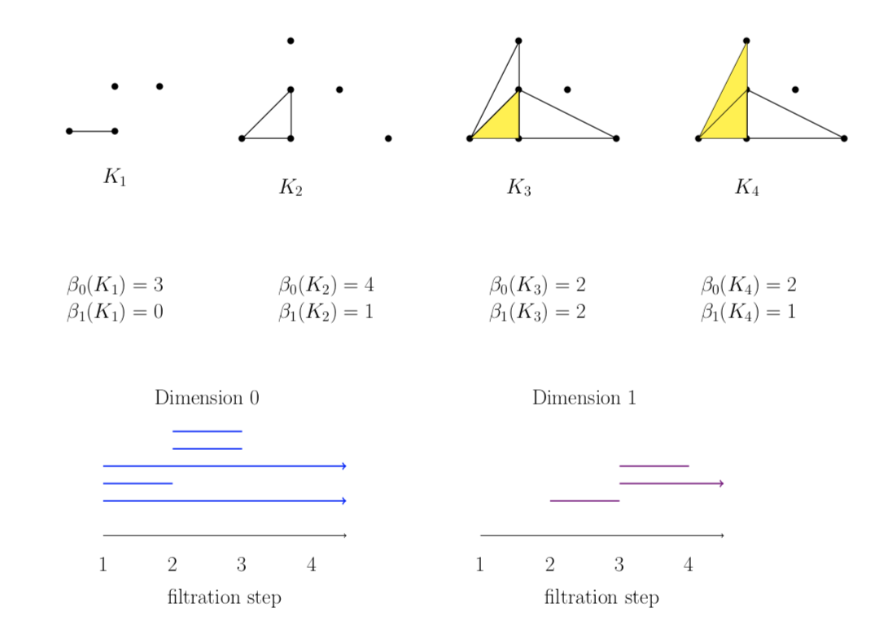
Step 3: Nested complexes to barcode
Otter et al., arXiv, 2016.

Slide 28
Barcodes vs persistence diagrams (PD)
Notes:
Euler characteristic

Slide 29
Stability
The set of barcodes/persistence diagrams can be equipped with a variety of earthmover-type distances: the Wasserstein distances of L_{p}-type and the bottleneck distance of L∞ -type.
Most reasonable known instantiations of the TDA pipeline are Lipschitz continuous with respect to Hausdorff distance on point clouds and bottleneck distance on persistence diagrams.

Slide 30
Practicalities
There are extensive libraries of software, mostly open source, for TDA computations (e.g., GUDHI, Ripser, Flagser, Giotto-TDA,…).
There exist “inverse analysis” tools for interpreting results of TDA computations (e.g., work of Hiraoka et al.).
Notes:
Names to keep in mind: Chazal, Oudot, Hiraoka, Bauer, Edelsbrunner, Chacholski, Perea, Munch, Curry, Fasy,

Slide 31
From one to many parameters
In real data, there are often several parameters along which it would be natural to filter (e.g., some notion of density or time).
Generalization from one to many parameters poses serious problems, for reasons of both theory and implementation: in general, there is no analogue of barcodes or persistence diagrams.
Common approaches for two parameters
  Restrict to lines in the plane determined by the two parameters: fibered bar code.
  Focus on decompositions into blocks (instead of bars) when possible.

Slide 32
Static TDA input to ML

Slide 33
Strategies for vectorization/featurization
Problem: Cannot compute statistics in the space of barcodes or the space of persistence diagrams.
Solution:
  Define a Lipschitz-continuous mapping from the space of barcodes/persistence diagrams to a vector space 𝒱 equipped with an inner product.
  Compute statistics in 𝒱!
  Two main types:
    Embeddings into finite-dimensional Euclidean spaces
    Kernel methods: defining generalized scalar product on PD, i.e., see PD as elements of a Hilbert space
Few trainable parameters
Expensive
Notes:
New differentiable approaches, enabling gradient descent, due to

Slide 34
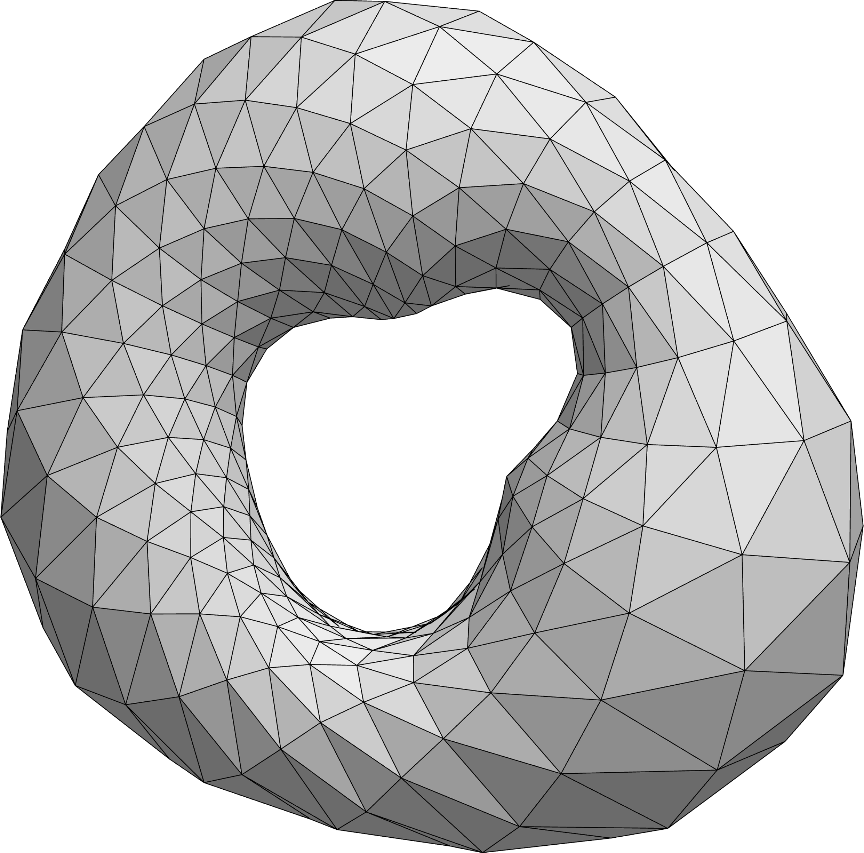
Cavities
By Fashionslide at English Wikipedia, CC BY-SA 4.0

Slide 35
Betti curves
0 1 2 3 4 5
Bar code for cavities of dimension k
Betti_k curve

Slide 36
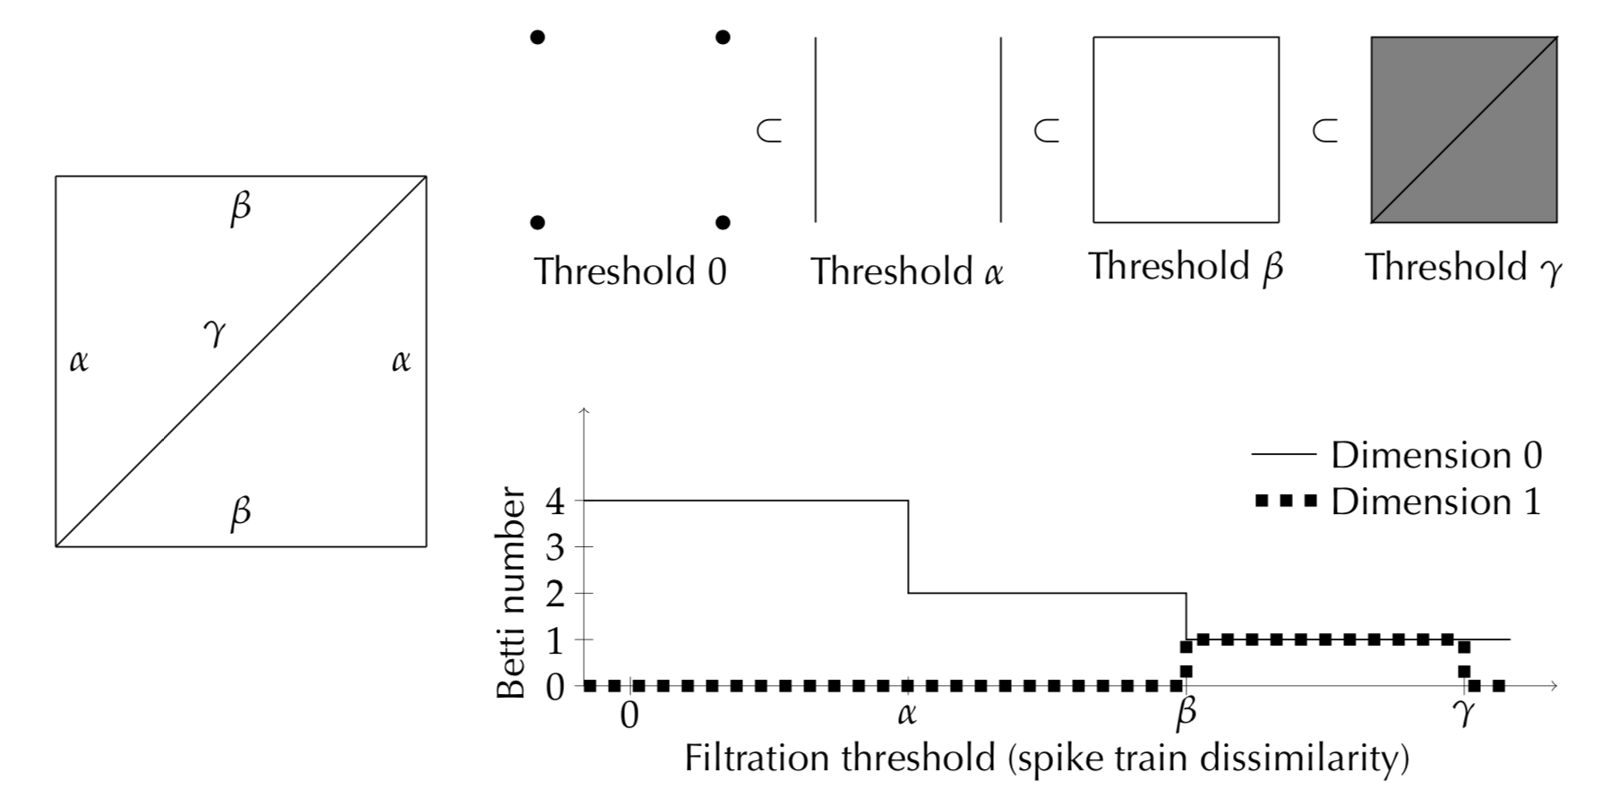
Nested complex to Betti curve
Bardin, et al., Network Neuroscience, 2019.

Slide 37
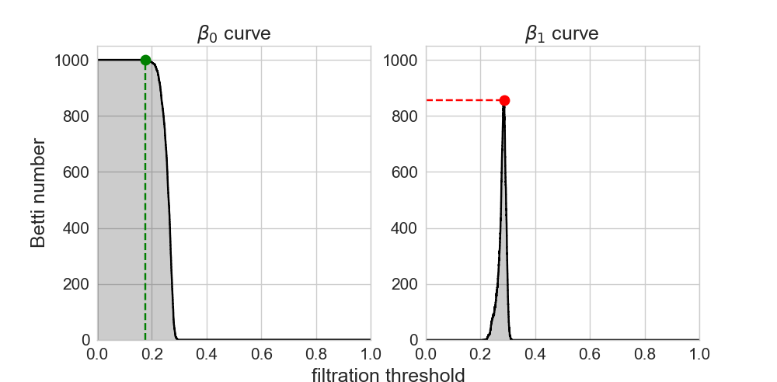
Extracting numerical features
Bardin, et al., Network Neuroscience, 2019.

Slide 38
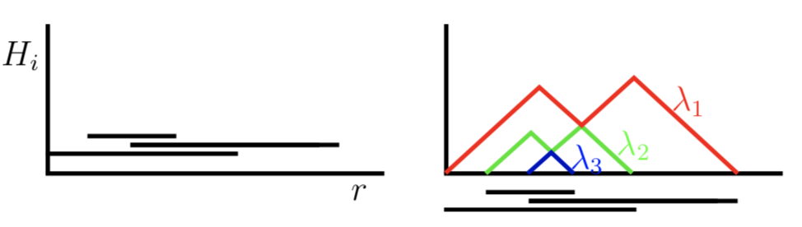

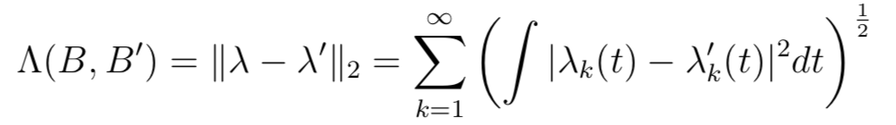
Persistence landscapes
Barcodes also give rise to persistence landscapes.
The L2-landscape distance between barcodes B and B’ with associated landscapes 𝛌 and 𝛌’:
Bubenik, JMLR 2015
Dlotko & Bubenik, J Symbolic Comp 2017

Slide 39
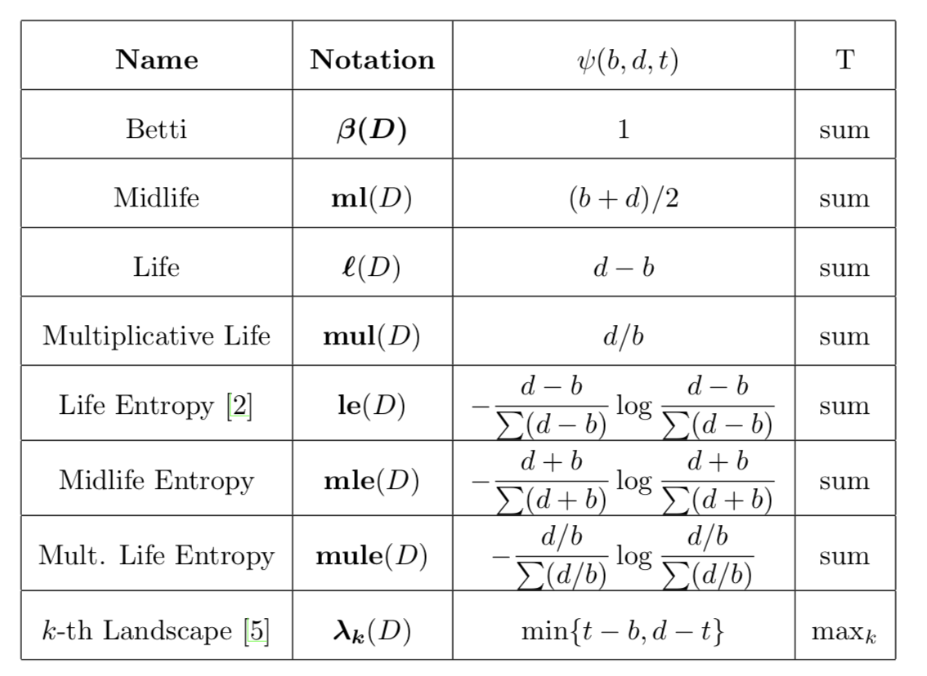
Persistence curves
Simultaneous generalization of
Betti curves and persistence
landscapes. Robust to input noise, efficient to compute, interpretable, and allowing weighting of relative importance of different regions in the PD.
For each t, compute T({ 𝜓(b,d,t) | b ≤ t, d > t}).
Chung and Lawson, arXiv, 2019

Slide 40
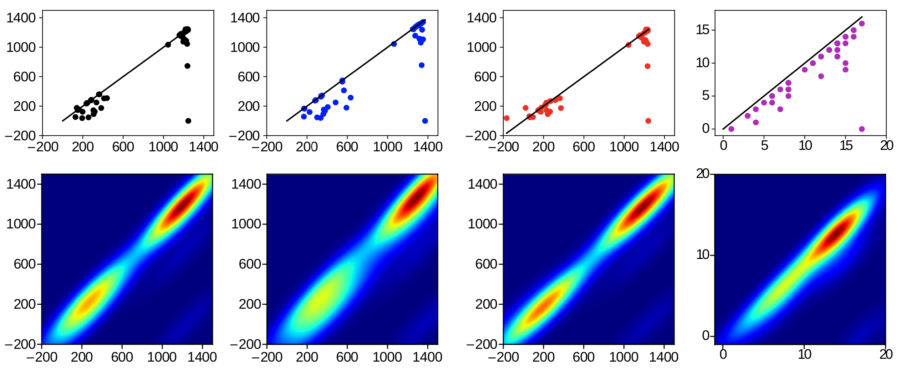
Persistence images
Smooth the PD: replace each point by a Gaussian kernel, then sum
Discretize
(Image from Kanari, et al., Neuroinformatics, 2018.)
Adams et al., JMLR 2017

Slide 41
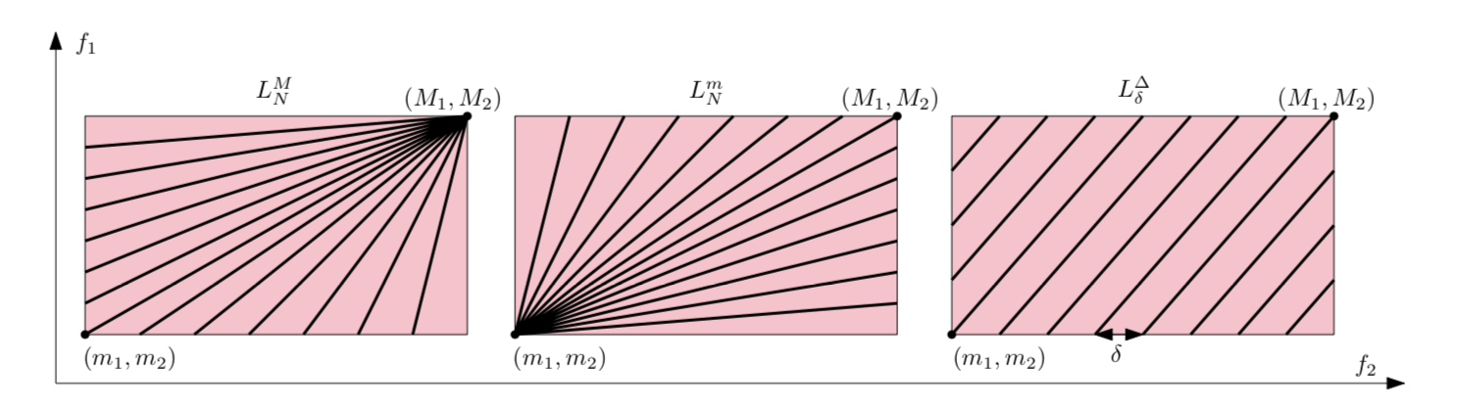
Multiparameter persistence images
Two-parameter version of the preceding idea, based on collections of fibered barcodes equipped with matchings between adjacent lines.
Carrière and Blumberg, NeurIPS 2020

Slide 42
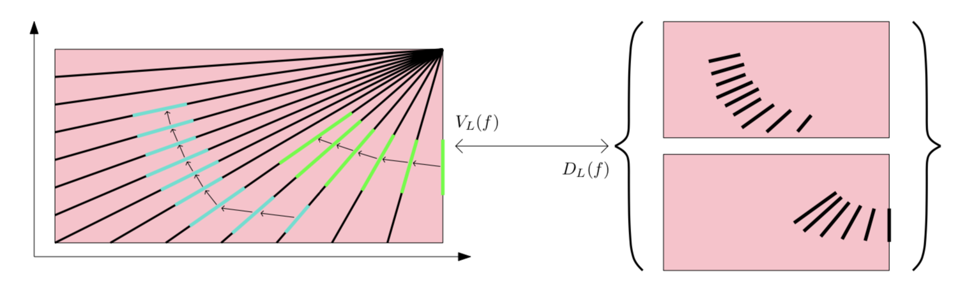
Multiparameter persistence images
Two-parameter version of the preceding idea, based on collections of fibered barcodes equipped with matchings between adjacent lines.
Carrière and Blumberg, NeurIPS 2020

Slide 43
Multiparameter persistence images
Two-parameter version of the preceding idea, based on collections of fibered barcodes equipped with matchings between adjacent lines.
Robust to noise
Matches or outperforms other multiparameter methods, e.g., in predicting cancer survival from tumor images.
Carrière and Blumberg, NeurIPS 2020

Slide 44
ML methods applied to vectorized TDA
Decision tree
Random forest
Support Vector Machine
CNN
GNN
Also possible to integrate a TDA layer into an ML model!

Slide 45
Applications

Slide 46
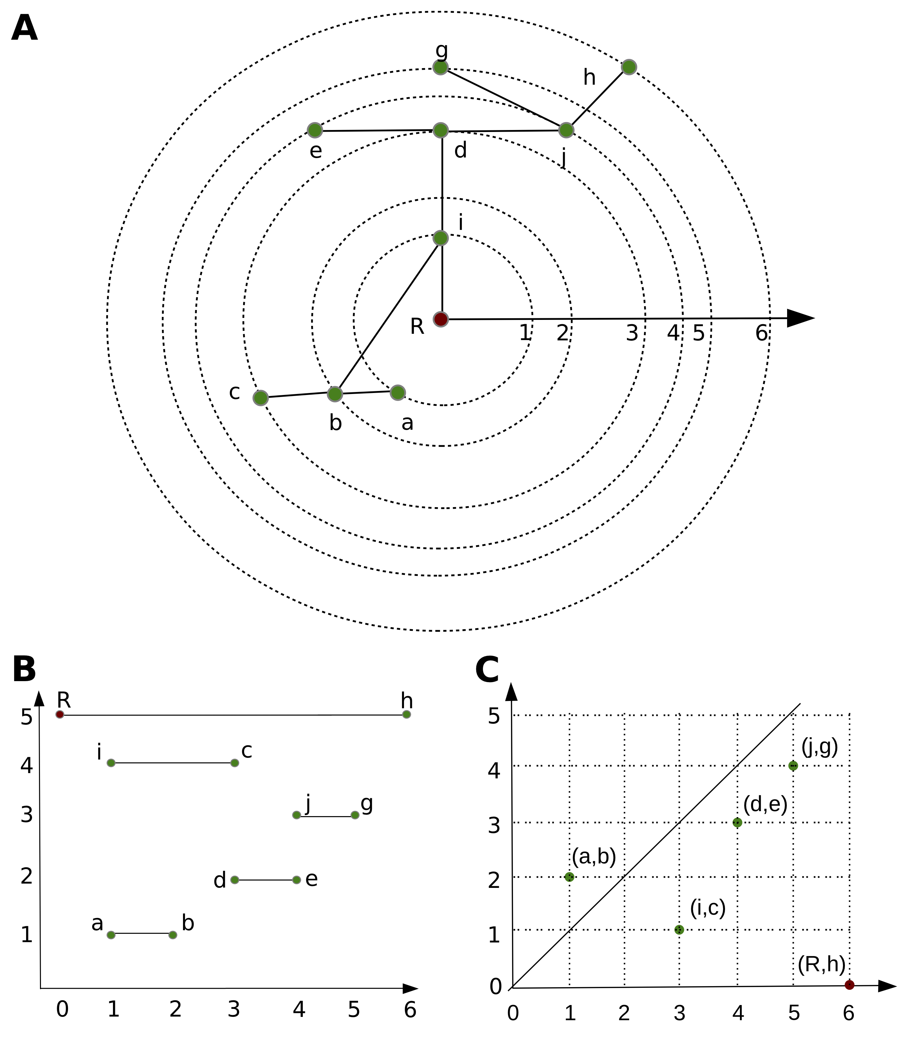
Classification of neuron morphologies
Idea: Starting at the leaves and descending
recursively to the root, decompose the tree
into branches, while respecting the Elder Rule,
i.e., at any bifurcation, the elder (longer) branch
survives and the younger branch is broken off.
Integrate the topology of the tree and the
geometry of its embedding in space into a
surprisingly powerful global descriptor.
Kanari et al., Neuroinformatics 2017
Kanari et al., Cerebral Cortex 2019

Slide 47
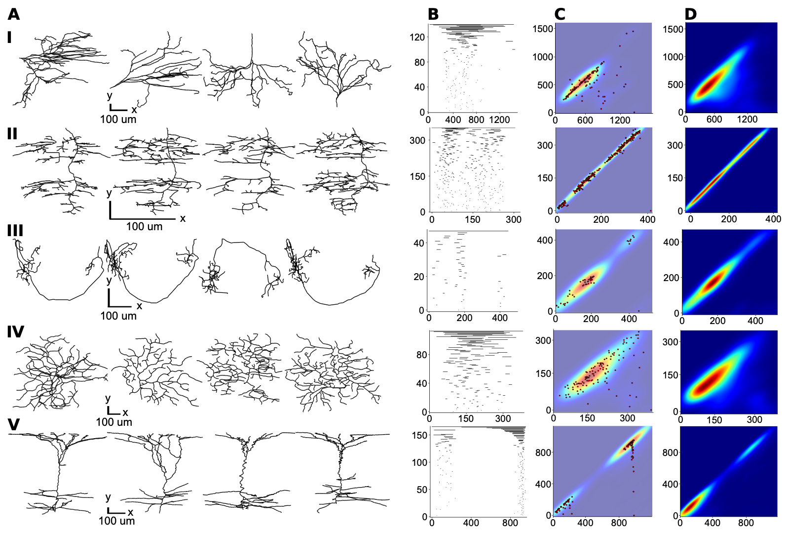
Classification of neuron morphologies
Kanari et al., Neuroinformatics 2017
Kanari et al., Cerebral Cortex 2019

Slide 48
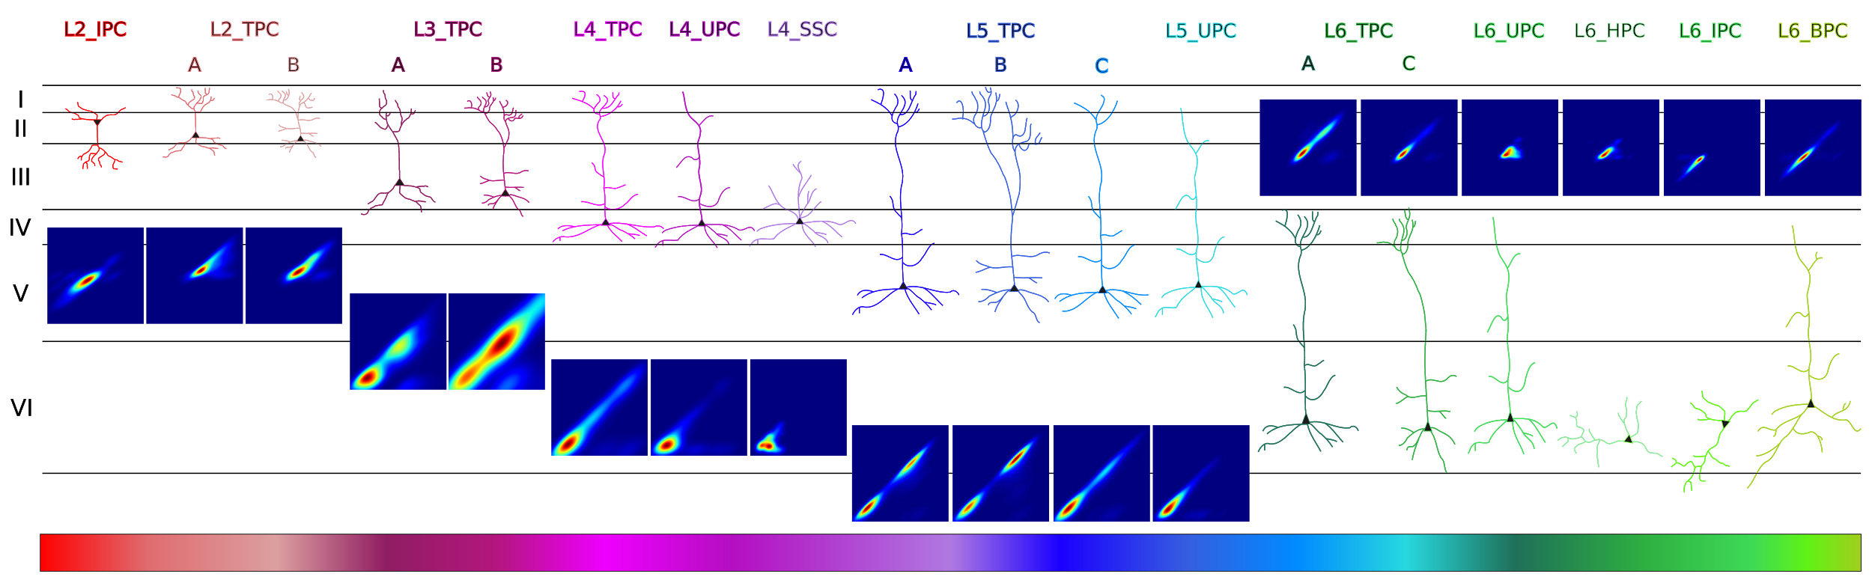
Classification of neuron morphologies
Kanari et al., Neuroinformatics 2017
Kanari et al., Cerebral Cortex 2019
Notes:
Tasks: 1. Find an algorithm to objectively separate different cell types, 2. Explain differences between cell types

Slide 49
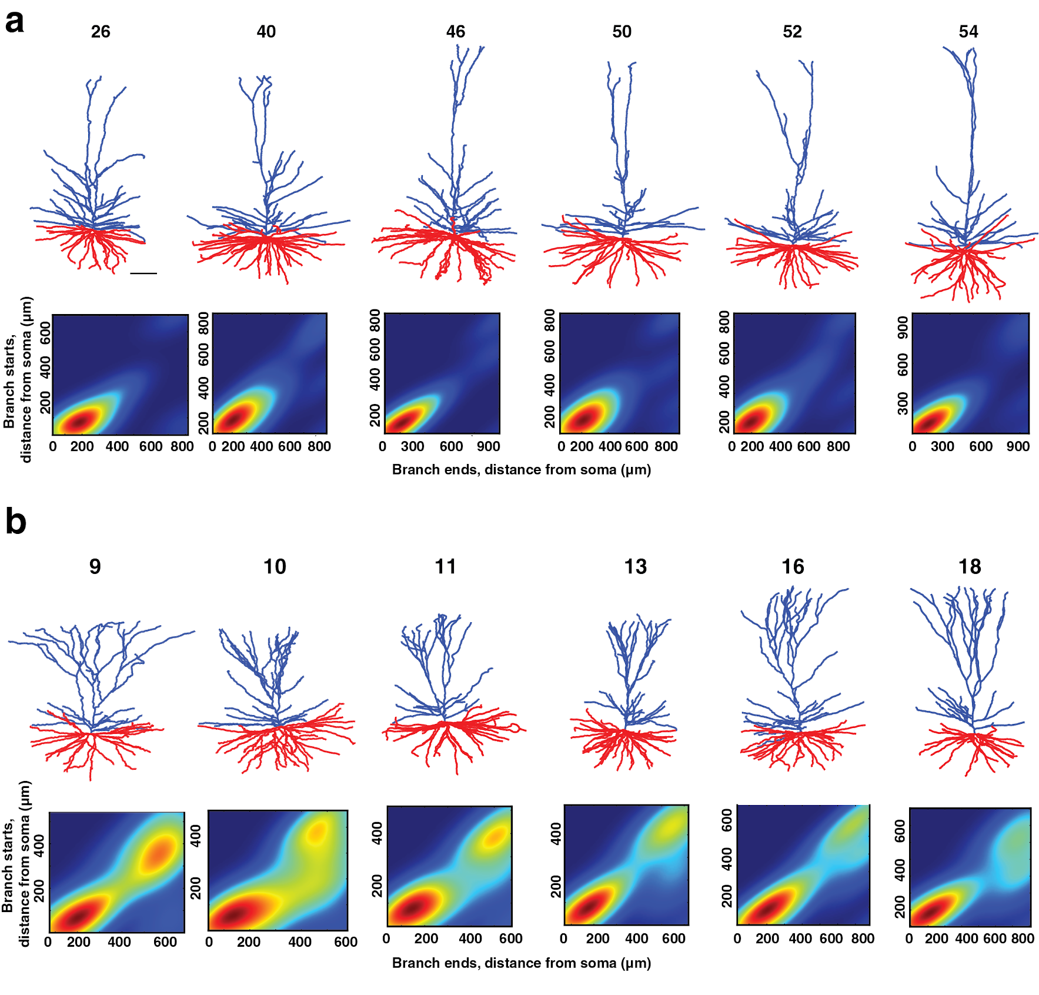
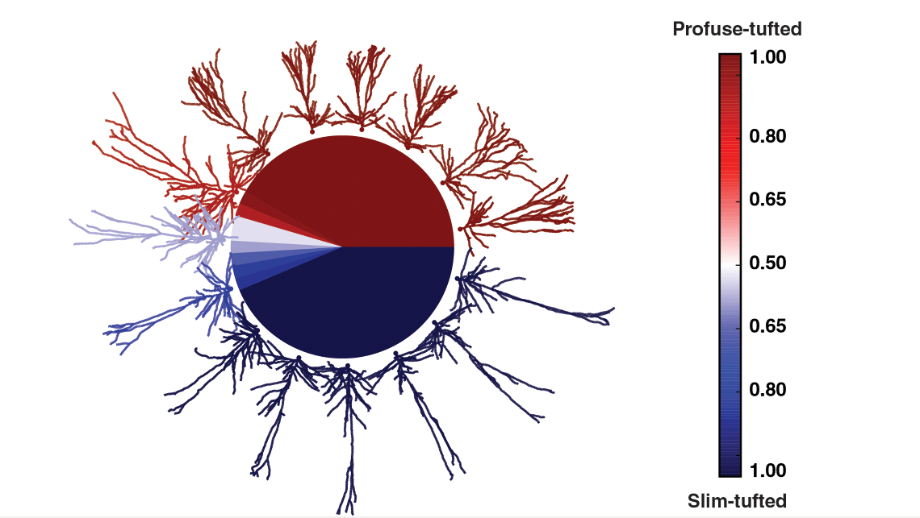
Classification of neuron morphologies
Kanari et al., Cerebral Cortex 2017
Notes:
Tasks: 1. Find an algorithm to objectively separate different cell types, 2. Explain differences between cell types

Slide 50
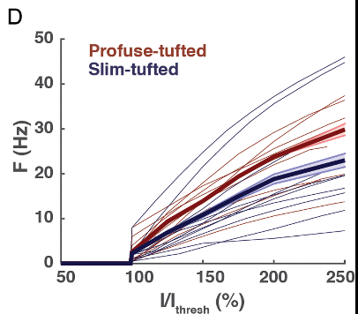
Classification of neuron morphologies
Kanari et al., Cerebral Cortex 2017
Notes:
Tasks: 1. Find an algorithm to objectively separate different cell types, 2. Explain differences between cell types

Slide 51
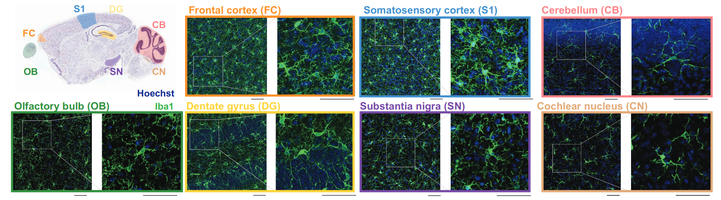
Classification of microglia
Colombo, et al., Nature Neuroscience, 2022.

Slide 52
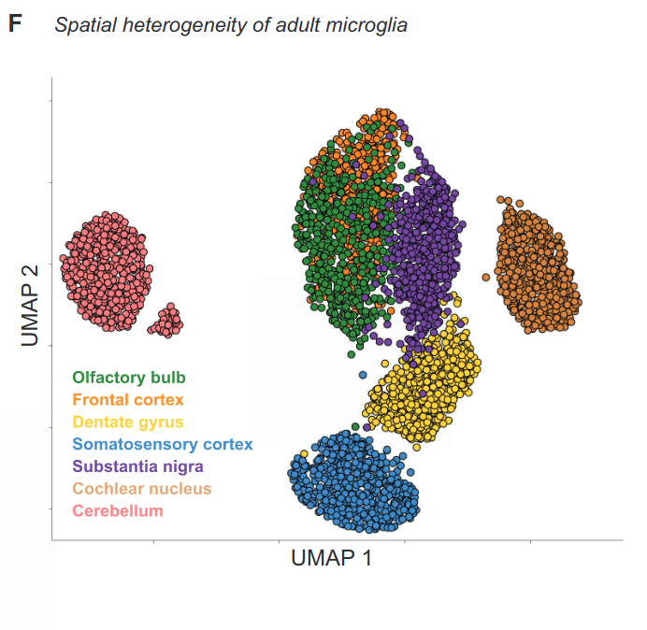
Classification of microglia
Colombo, et al., Nature Neuroscience, 2022.

Slide 53
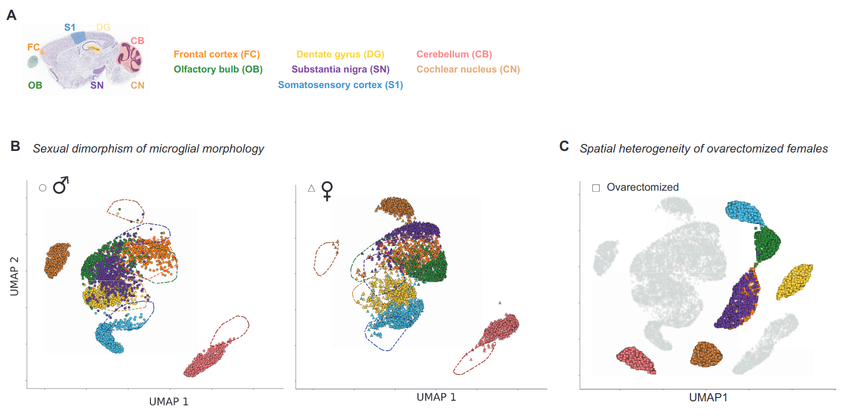
Application: classification of microglia
Colombo, et al., Nature Neuroscience, 2022.

Slide 54
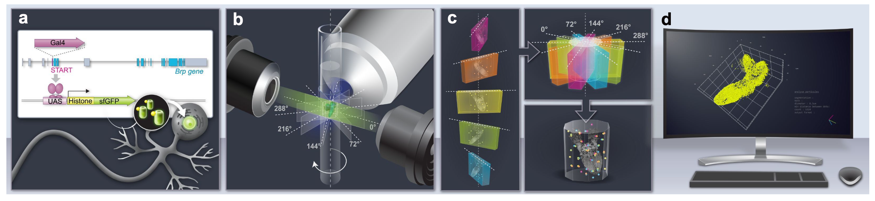
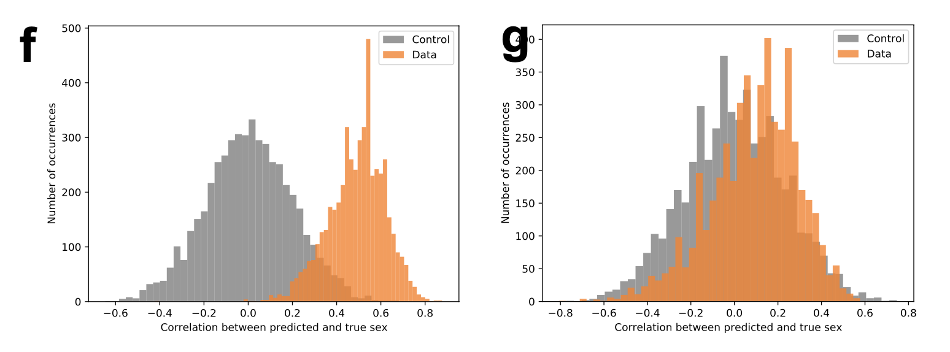
Sexual dichotomy in larval fruitflies
Jiao et al, eLife, 2022

Slide 55
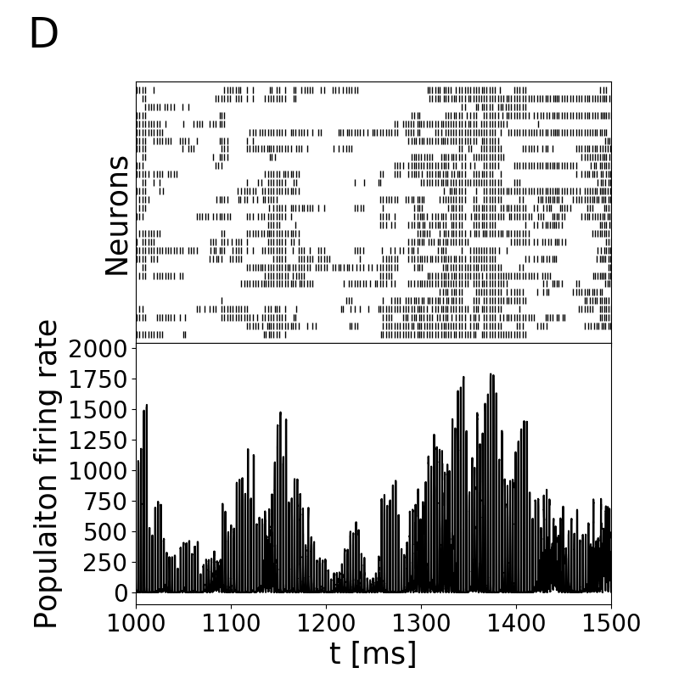
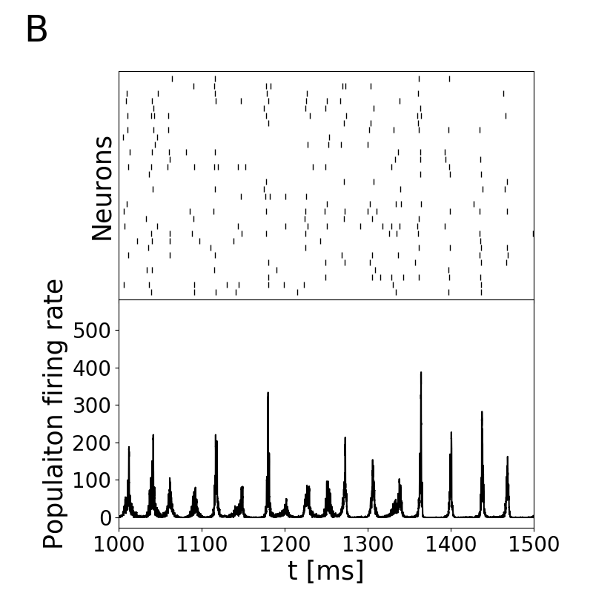
Classification of neural dynamics
  For a range of activity parameters, associate to an active Brunel network a weighted graph, to which we apply tools of persistent homology.
  Extract simple topological features of each dynamic regime.
  Use these to train a (highly accurate!) classifier.
Bardin, et al., Network Neuroscience, 2019.

Slide 56
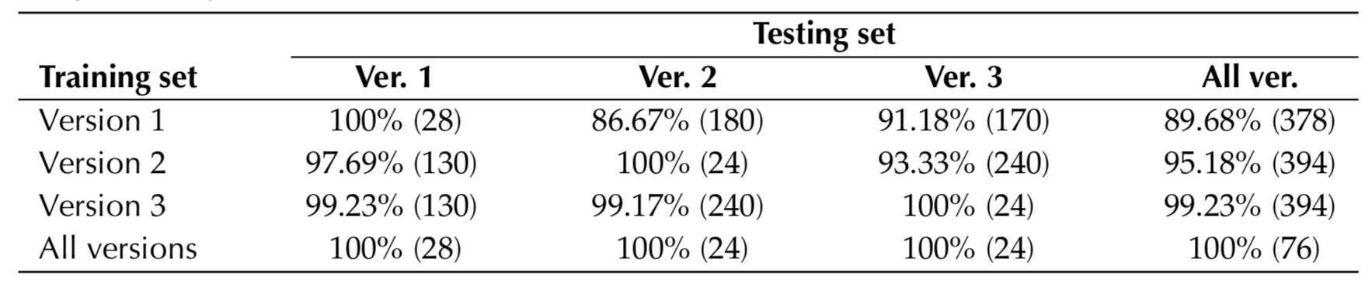
Classification of neural dynamics
Automated classification of network dynamics
  For a range of activity parameters, associate to an active Brunel network a weighted graph, to which we apply tools of persistent homology.
  Extract simple topological features of each dynamic regime.
  Use these to train a (highly accurate!) classifier.
Bardin, et al., Network Neuroscience, 2019.

Slide 57
Classification of nanoporous crystalline materials
Lee et al., Nature Communications 2017
Lee et al., J Chem Thy Comput 2018

Slide 58
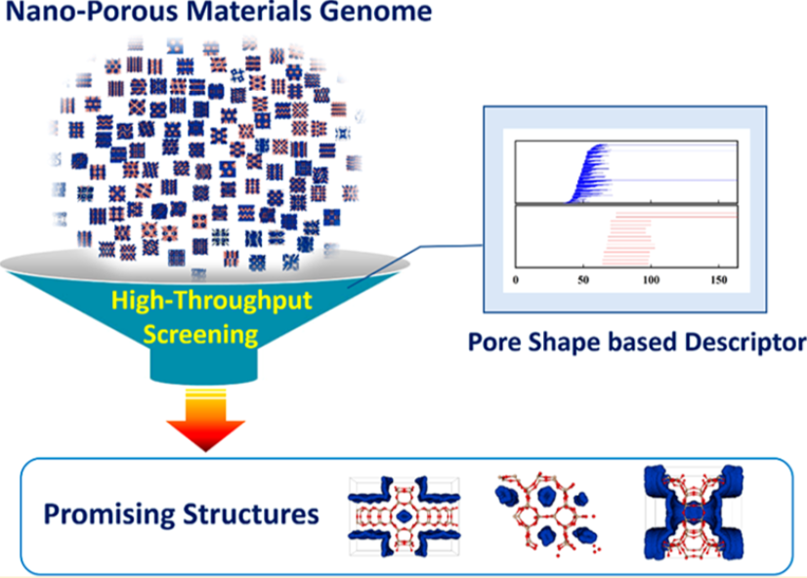
Classification of nanoporous crystalline materials
Lee et al., Nature Communications 2017
Lee et al., J Chem Thy Comput 2018

Slide 59
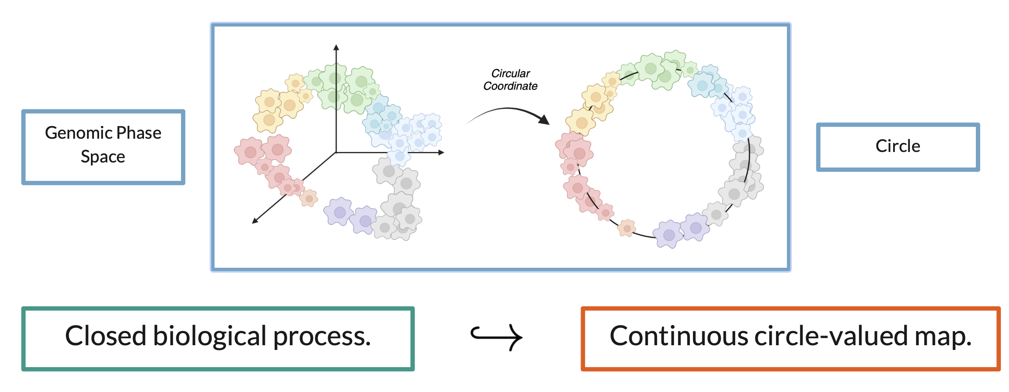
Detection of gene cascades in single-cell data
Idea: Generate biological hypotheses about closed processes in single-cell RNA seq data using topology and geometry
Maggs, Nguyen, Youssef, in progress

Slide 60
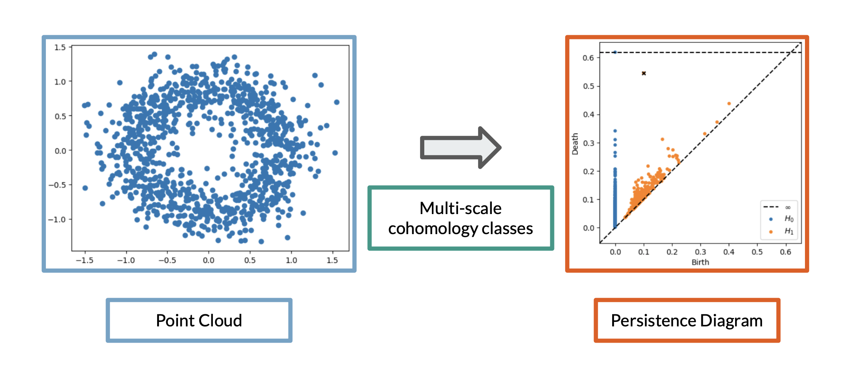
Detection of gene cascades in single-cell data
Idea: Generate biological hypotheses about closed processes in single-cell RNA seq data using topology and geometry
Maggs, Nguyen, Youssef, in progress

Slide 61
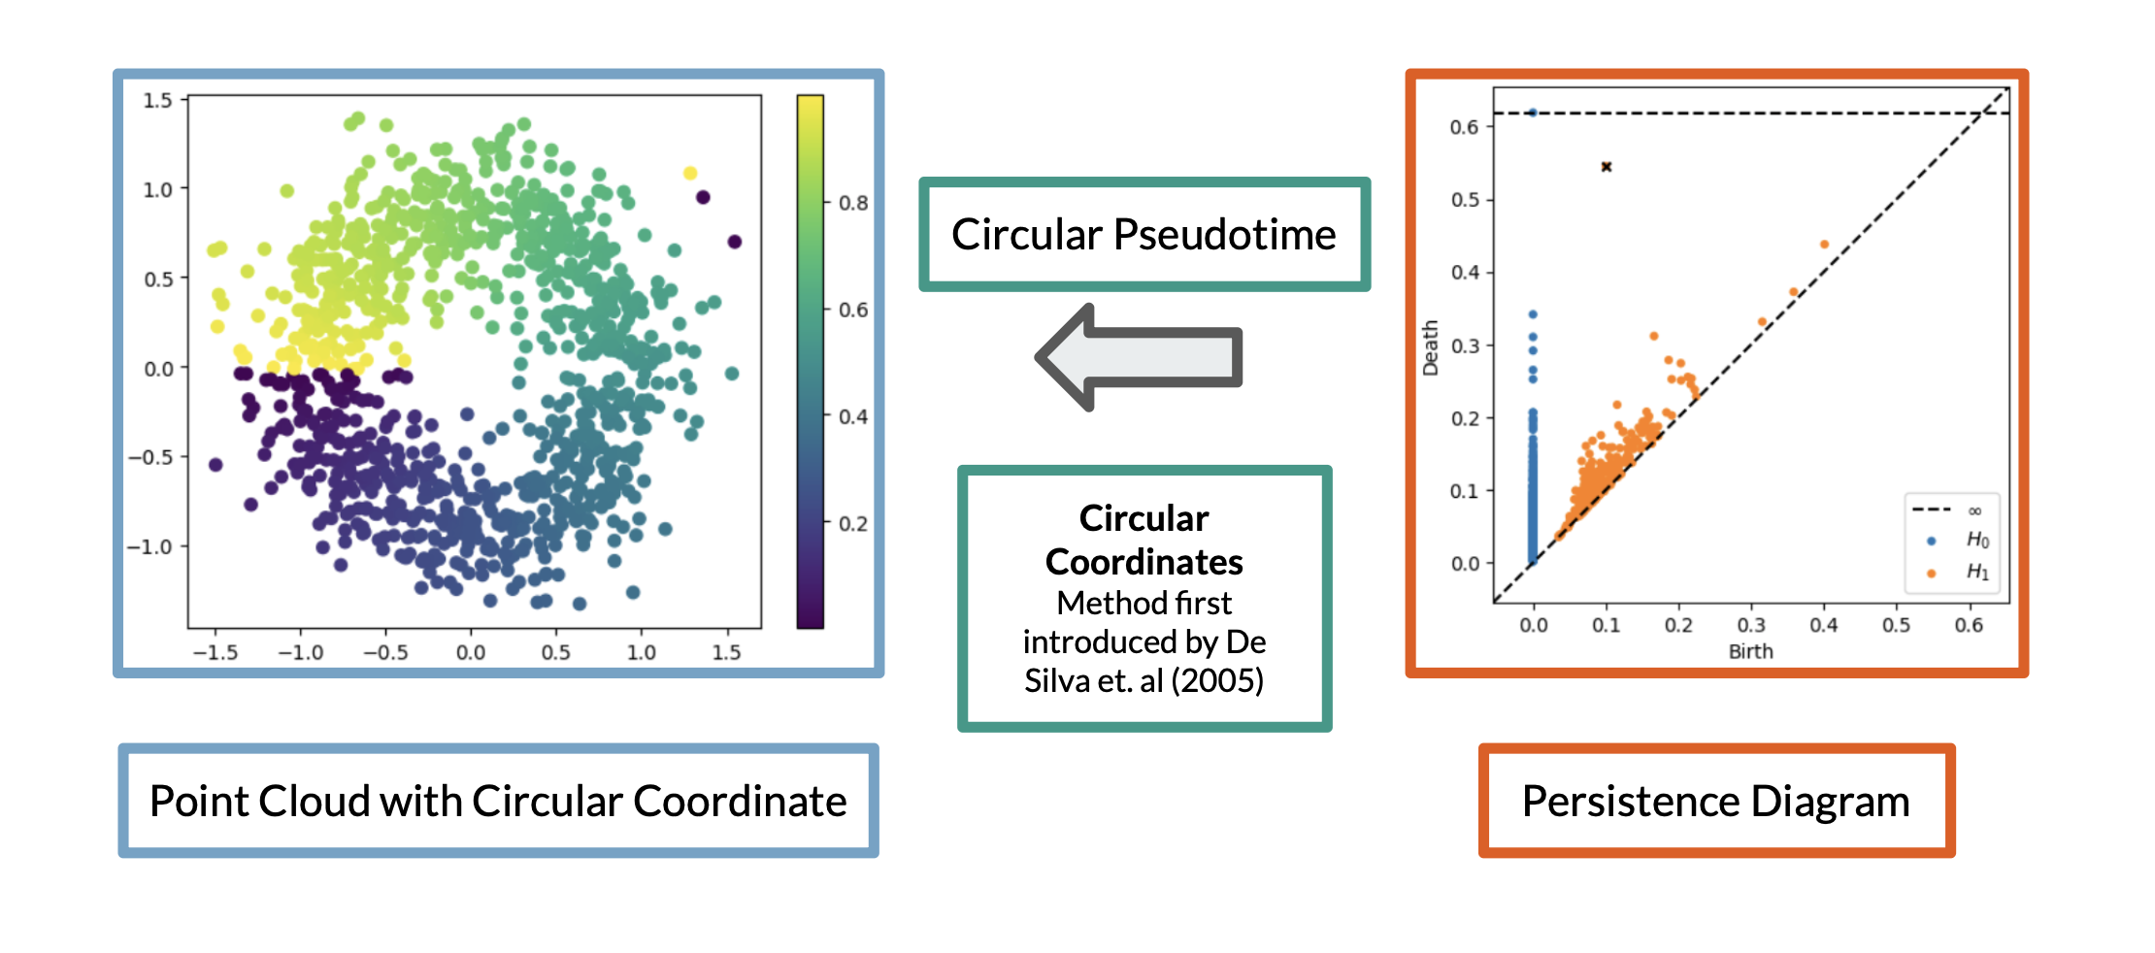
Detection of gene cascades in single-cell data
Idea: Generate biological hypotheses about closed processes in single-cell RNA seq data using topology and geometry
Maggs, Nguyen, Youssef, in progress

Slide 62
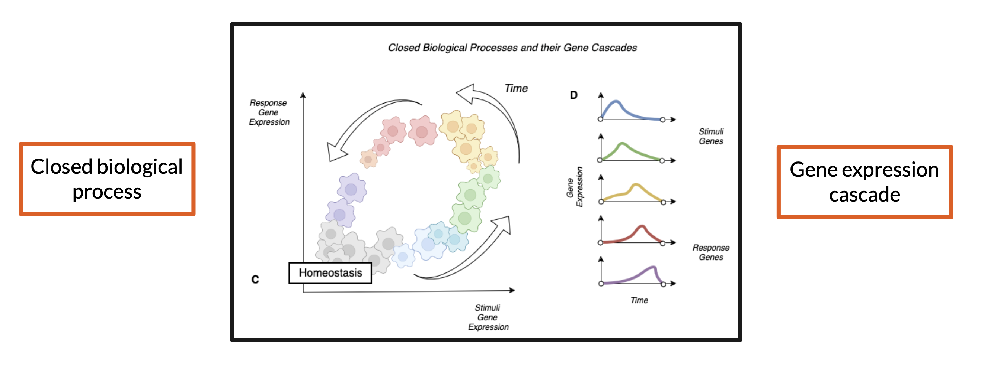
Detection of gene cascades in single-cell data
Maggs, Nguyen, Youssef, in progress

Slide 63
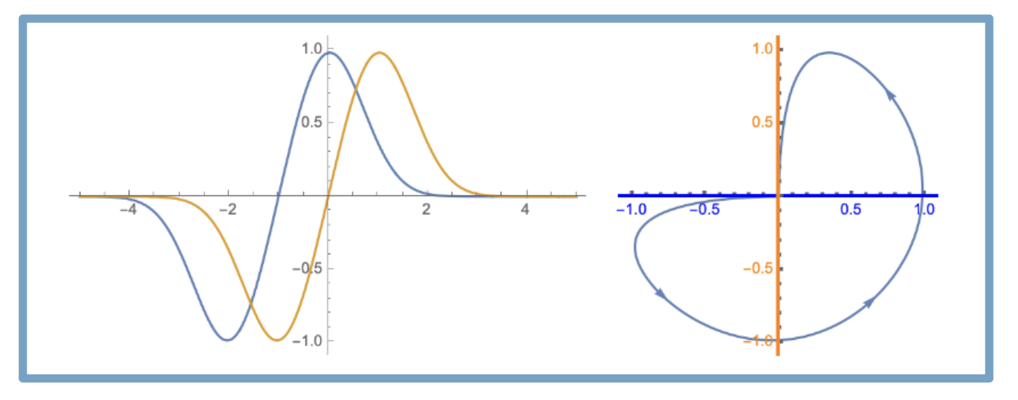
Detection of gene cascades in single-cell data
Maggs, Nguyen, Youssef, in progress

Slide 64
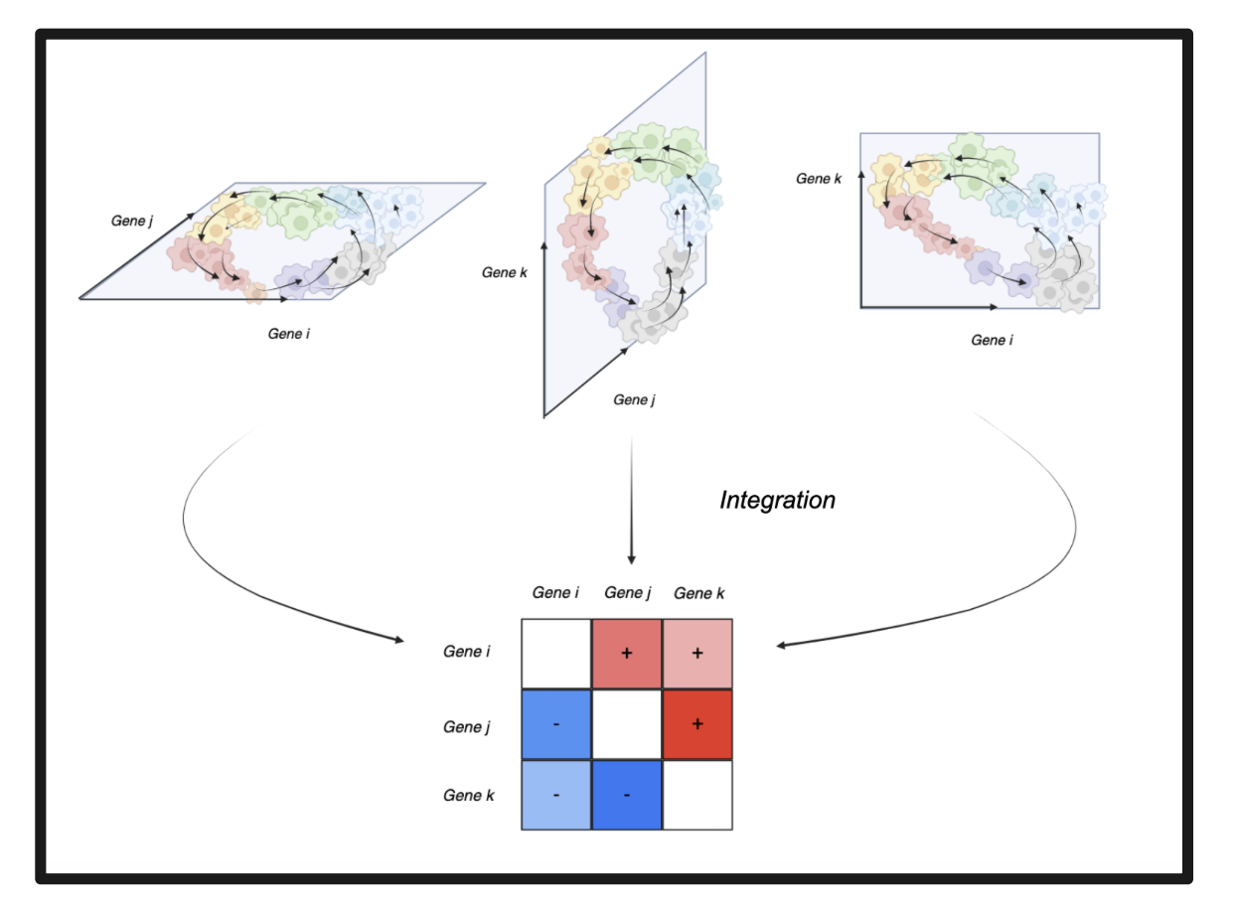
Detection of gene cascades in single-cell data
Maggs, Nguyen, Youssef, in progress

Slide 65
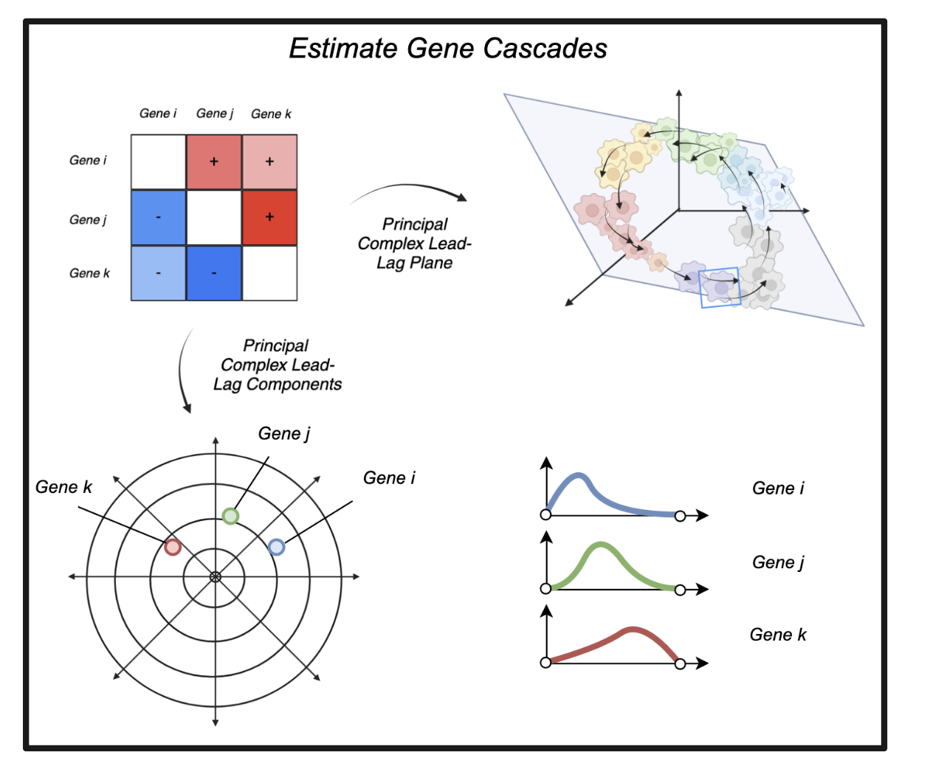
Detection of gene cascades in single-cell data
Maggs, Nguyen, Youssef, in progress

Slide 66

Detection of gene cascades in single-cell data
Maggs, Nguyen, Youssef, in progress

Slide 67

Thank you to our funding agencies
SNSF
Innosuisse
Blue Brain Project
Merci !
Members of the Laboratoire de
Topologie et Neurosciences

